Slide 1
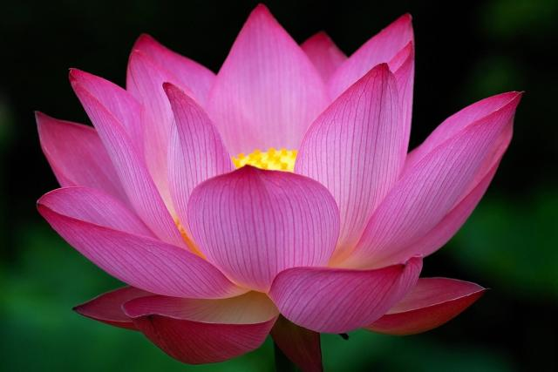
welcome

Slide 2
Introduction
Aklima Akter
Assistant teacher
Saildia Dakhil Madrasah
Kaligonj,Gazipur
Class:10
Subject:English 1st paper
Unit 3:Lesson:3

Slide 3
Today’s Topic is
International Mother Language Day-1

Slide 4
Learning Outcome
By the end of this lesson students will able to…..
Tell about the cause of the Language Movement.
Tell about why people go to the Shaheed Minar.
Explain the reaction of the students of Dhaka universities
Know some vocabularies.

Slide 5
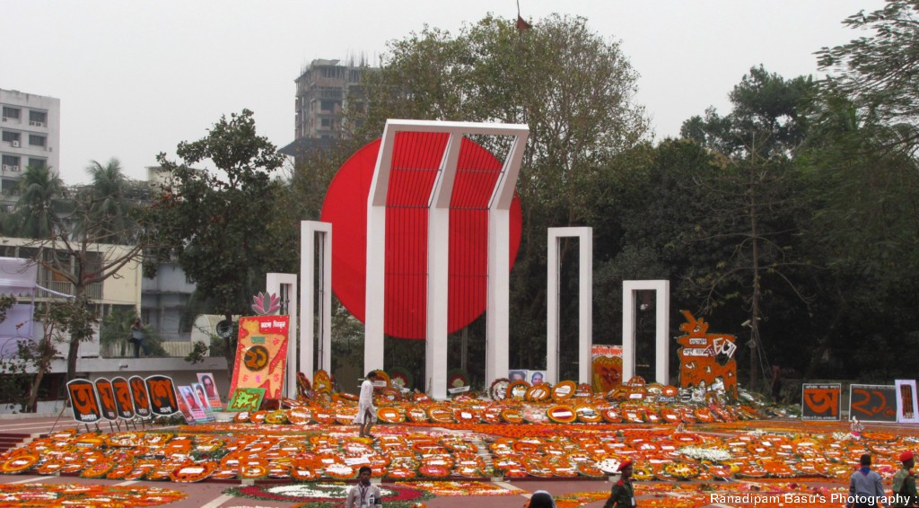
What is the picture about?

Slide 6
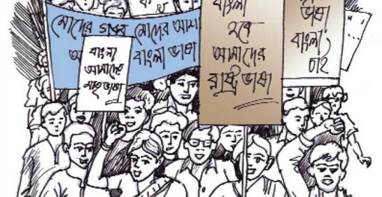
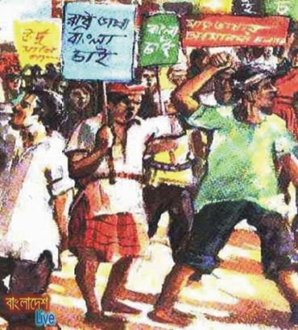
Vocabulary
Language
Sign of changing views or ideas
Revolution
Movement

Slide 7
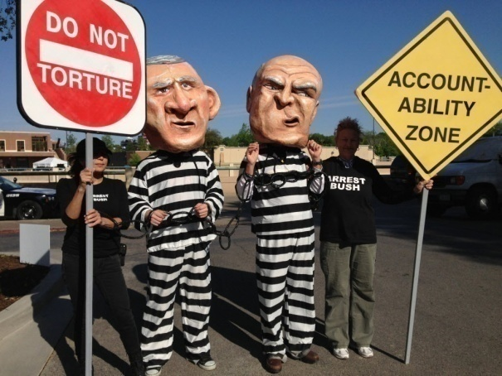
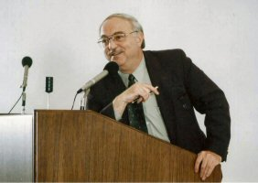

Protest
Oppose
Declare
Proclaim
Celebrate
Observe

Slide 8
Evaluation
Who declared Urdu would be the only state language of Pakistan?
What happened when Urdu was declared as the only state language of Pakistan.
Why is 21 February called Shaheed Dibos?
Write the name of the Language Movement Martyrs.

Slide 9
Home Work
“Why is 21 February now observed throughout the world every year?”

Slide 10

Thank you

